Slide 1
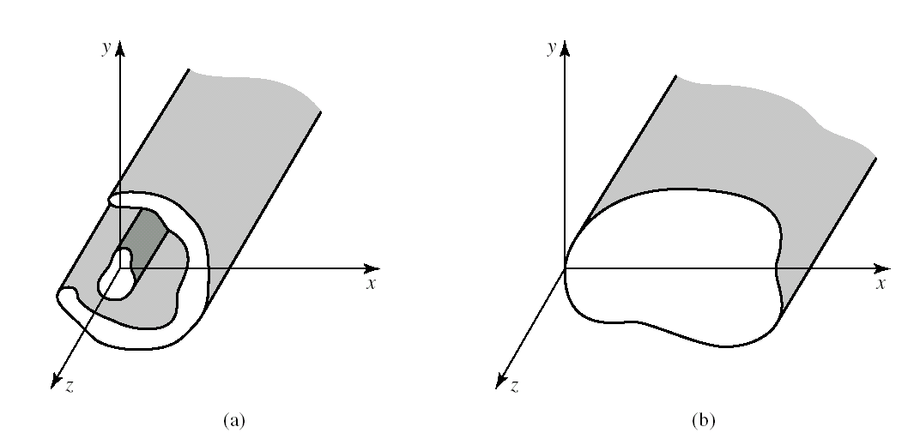
Chapter 4 Transmission Lines and Waveguide
§4.1 General Solutions for TEM, TE and TM waves
1) General Solutions
x,y: transverse directions
z: longitude direction
(a) General two-conductor transmission line and (b) closed waveguide.
Notes:
规则波导？Regular waveguide
The conductors will initially
be assumed to be perfectly conducting, but attenuation can be found by the perturbation
method discussed in Chapter 2.
研究波导中的电磁场问题，实质上就是求满足波导内壁边界条件的Maxwell方程组
为使问题更简单化并考虑实用性，作如下假设：
波导无限长
波导内壁是理想导电面（σ＝∞）
波导内为理想介质（ε、μ为实数常数）
波导内为无源区域(ρ=0,J=0)，且远离波源。
波导中的场随时间作简谐变化，可用复数形式表示
规则金属波导管壁材料一般由铜、铝制成，有时其内壁上镀金或银，并且波导内一般无填充物，这样在上述假设下所得场解与实际情况相比不会有明显的误差。

Slide 2
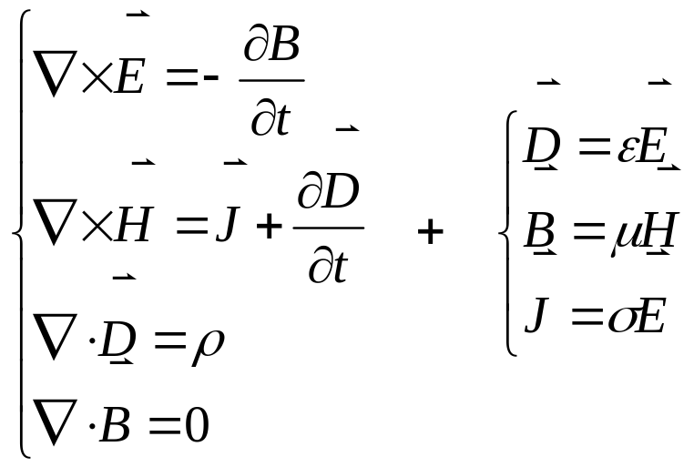
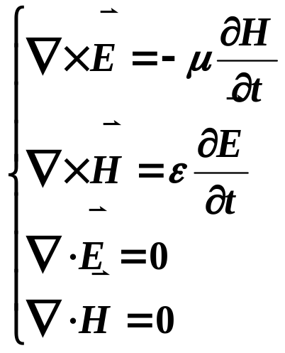
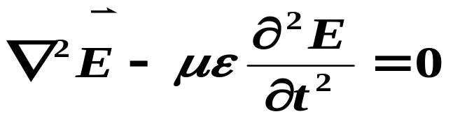
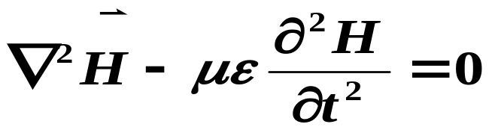
§4.1 General Solutions for TEM, TE and TM waves
Maxwell equations → wave equations
Assume that the transmission line or waveguide region is source free
filled with loss free dielectric material
J=ρ =0, and σ=0
μ、ε are real const.
μ Magnetic permeability
ε Dielectric constant
Notes:
Assume the transmission line is filled with perfect dielectric and

Slide 3
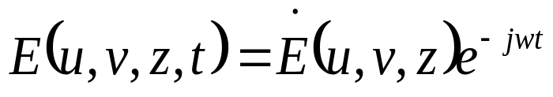
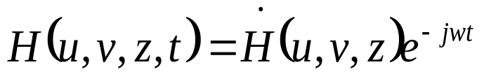
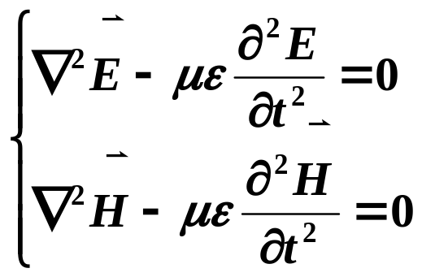
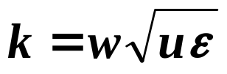
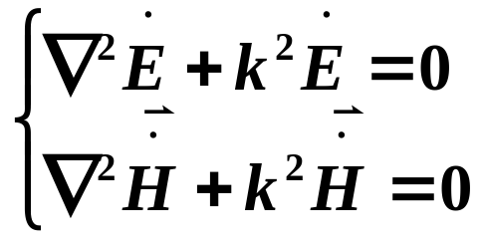
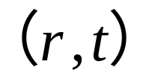

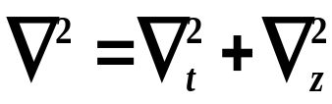

§4.1 General Solutions for TEM, TE and TM waves
Assume time-harmonic field with e^{jwt} dependence
u,v: transverse
z: longitude
Assume wave propagation along the z-axis
Notes:
Transverse electric and magnetic field Et and Ht
Longitudinal electric and magnetic field components
If conductor or dielectric loss is present the propagation constant will be complex.

Slide 4

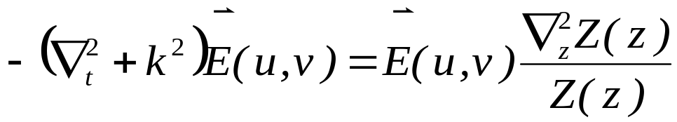
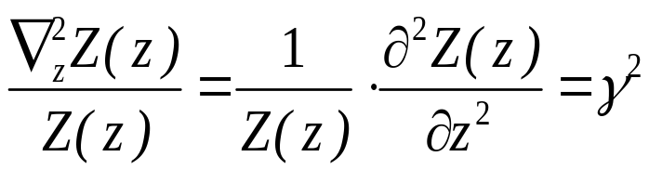
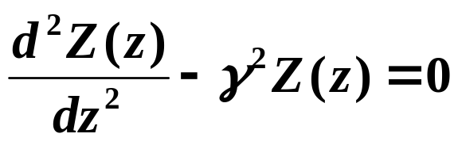
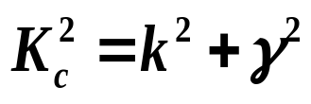
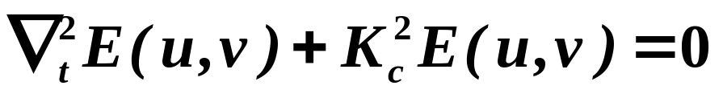
§4.1 General Solutions for TEM, TE and TM waves
let
Notes:
理想： Kc2＝k2－β2
K＝KC时，β=0，波不再沿z轴传播，称截止状态; KC称为截止波数
Kc大小与波导横截面的形状、尺寸，以及所传输的波型有关。

Slide 5
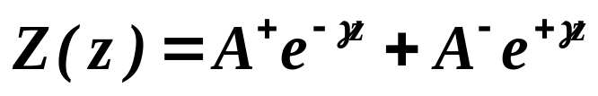

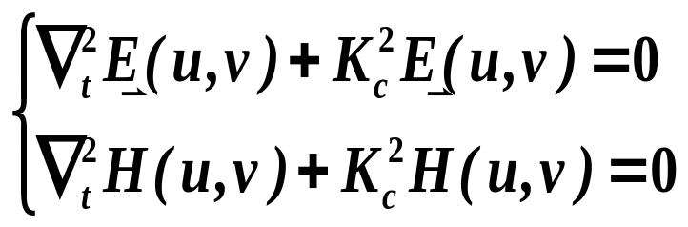
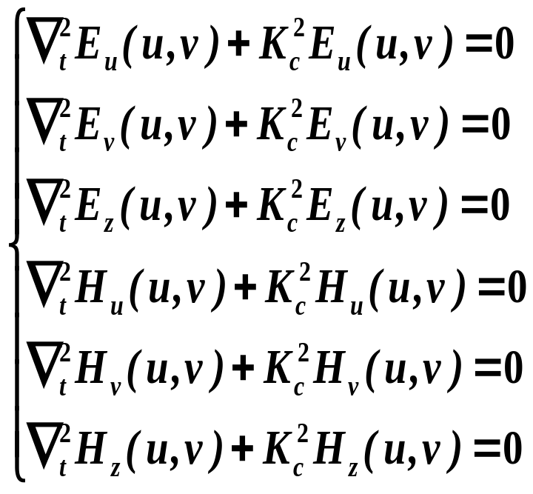
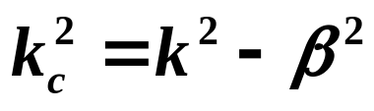
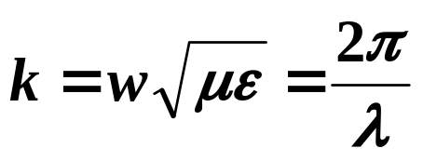
§4.1 General Solutions for TEM, TE and TM waves
Cutoff wavenumber

Slide 6
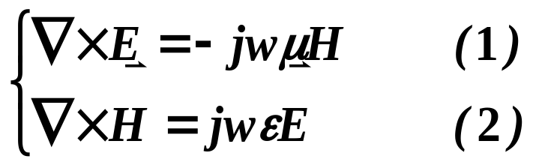
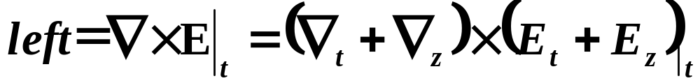
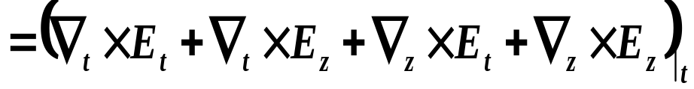

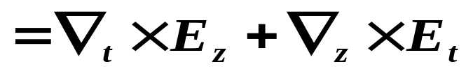
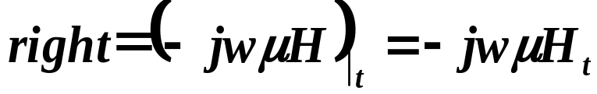
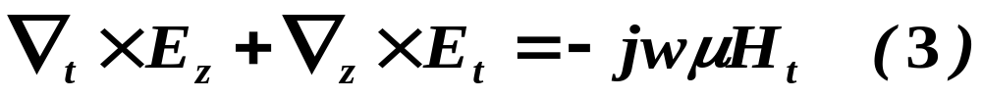
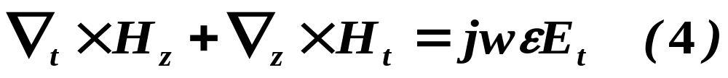
§4.1 General Solutions for TEM, TE and TM waves
Relation between transverse fields and longitude fields

Slide 7


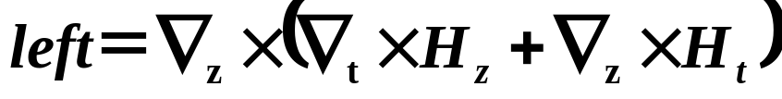
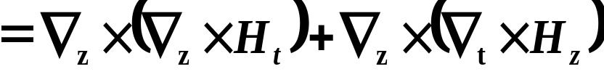



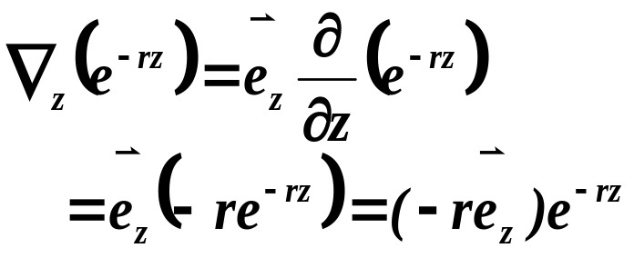
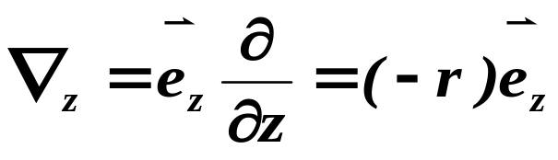
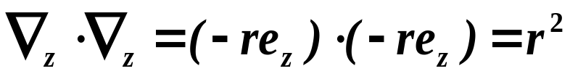
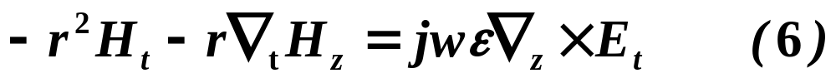
§4.1 General Solutions for TEM, TE and TM Waves
Equ.(4)×∇_{z}

Slide 8






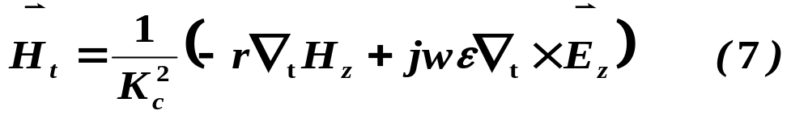
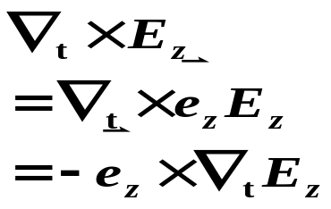
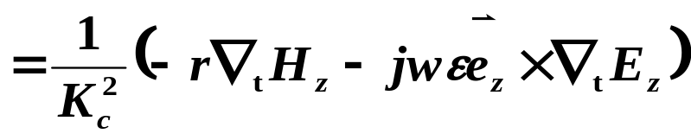
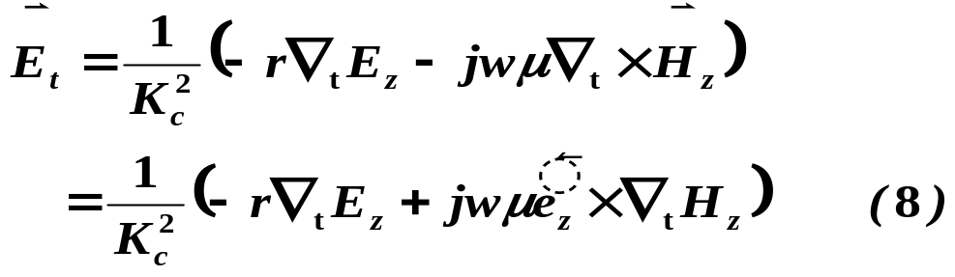
§4.1 General Solutions for TEM, TE and TM waves
Divided by K_{c}²
Similarly：

Slide 9
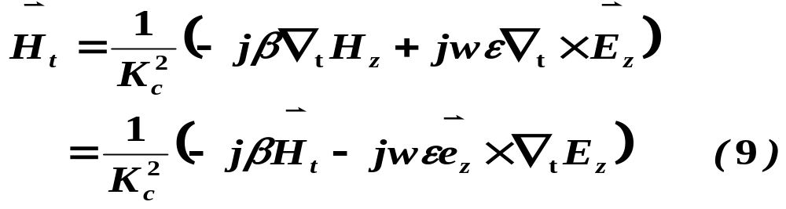
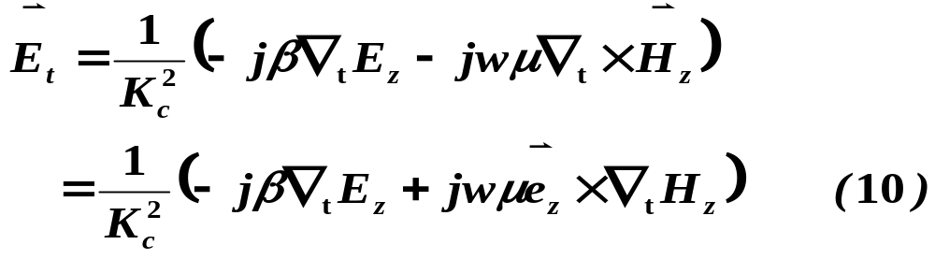
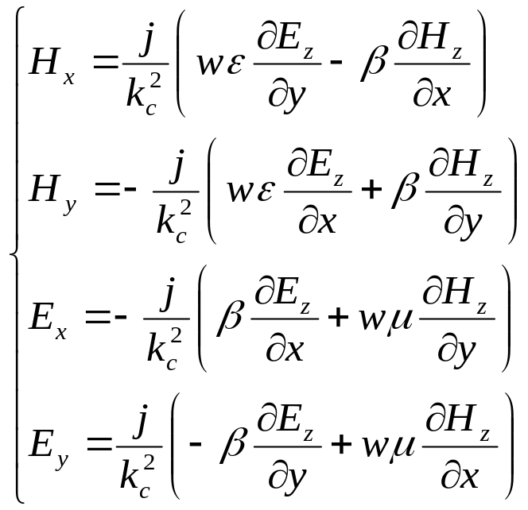
§4.1 General Solutions for TEM, TE and TM waves
If γ＝jβ，k_{c}²= k²-β², then

Slide 10
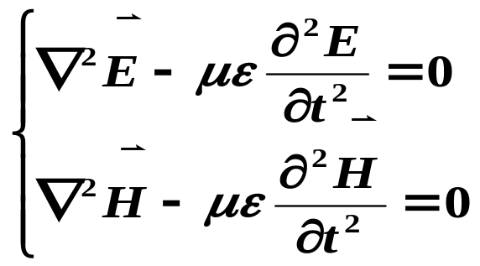





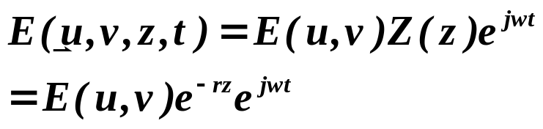
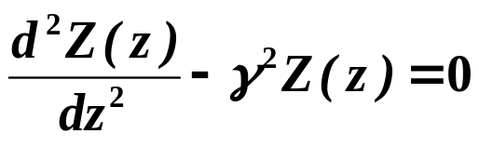


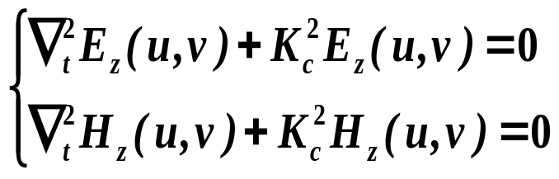
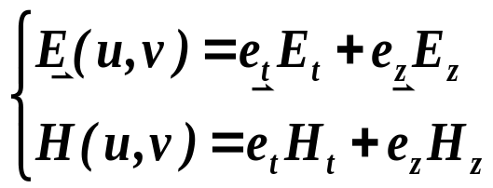
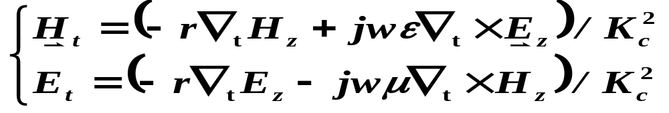
§4.1 General Solutions for TEM, TE and TM waves
（1） (u,v,z,t)
(2) (u,v,z)
e^{jwt}
(3) (u,v)

Slide 11

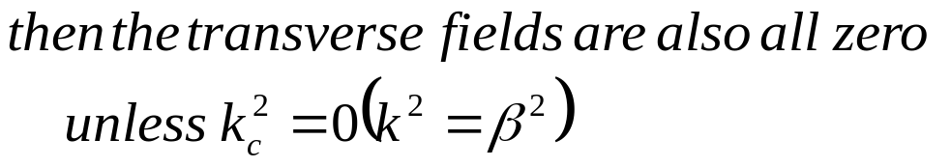
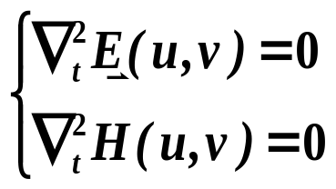

§4.1 General Solutions for TEM, TE and TM waves
2) TEM Waves
The transverse electric/magnetic fields of a TEM wave satisfy Laplace’s equation.
The transverse fields of a TEM wave are thus the same as the static fields that can exist between the conductors.
Notes:
Four transverse field can be solved in the terms of Ez and Hz
These Equations are very useful general results that can be applied to a variety of wave guiding system.
We will now specialize these results to specific wave type

Slide 12





§4.1 General Solutions for TEM, TE and TM waves
In the electrostatic case:
Satisfies Laplace’ equation as expected from electrostatics
Voltage between two conductors
Current flow on a conductor
TEM waves can exist when two or more conductors are present.
A closed conductor cannot support TEM waves
Notes:
Since the corresponding static potential in such a region would be zero (or possibly a constant), leadting to E=0
静态场也满足同样的Laplace方程，因此一个导波系统若能传输TEM波型，则该系统中必然能存在静电荷或恒定电流，而在单导体所构成的空心金属波导管内，不可能存在静电荷或恒定电荷，因此也不可能传输TEM波型。
若是双导体或多导体，则可以传输TEM波型

Slide 13







§4.1 General Solutions for TEM, TE and TM waves
Wave impedance of a TEM mode
e^{jβz}
^{Ez=Hz=0}
Notes:
与特性阻抗区分

Slide 14







§4.1 General Solutions for TEM, TE and TM waves
Procedure for analyzing a TEM line
(1) Solve Laplace’s equation
(2) Find these constants by applying the boundary conditions for the known voltages on the conductors
(3)
(4)
(5) Propagation constant and the characteristic impedance

Slide 15









§4.1 General Solutions for TEM, TE and TM waves
3) TE Waves
Transverse electric wave, (also referred to as H-waves)

Slide 16



§4.1 General Solutions for TEM, TE and TM waves
In this case, Kc≠0 and
β is generally a function of frequency and the geometry of the line or guide
Wave impedance
frequency dependent
TE waves can be supported inside closed conductors, as well as between two or more conductors

Slide 17







§4.1 General Solutions for TEM, TE and TM waves
4) TM Waves
Transverse magnetic wave, (also referred to as E waves)

Slide 18


§4.1 General Solutions for TEM, TE and TM waves
In this case, Kc≠0 and
β is generally a function of frequency and the geometry of the line or guide
Wave impedance
frequency dependent
TM waves can be supported inside closed conductors, as well as between two or more conductors

Slide 19


§4.1 General Solutions for TEM, TE and TM waves
Procedure for analyzing a TE/TM line
(1) Solve the reduced Helmholtz equation
(2) Find the transverse fields from longitude fields
(3) Apply the boundary conditions to find the unknown constant and k_{c}
(4) Propagation constant and wave impedance

Slide 20







§4.1 General Solutions for TEM, TE and TM waves
4) Attenuation Due to Dielectric Loss
α_{c} attenuation constant due to conductor loss
(can be calculated using the perturbation method)
α_{d} attenuation constant due to dielectric loss

Slide 21





§4.1 General Solutions for TEM, TE and TM waves
Propagation constant: γ= α＋jβ，
if α_{c}＝0，then α_{d}＝ Re（γ）

Slide 22








§4.1 General Solutions for TEM, TE and TM waves

